Slide 1
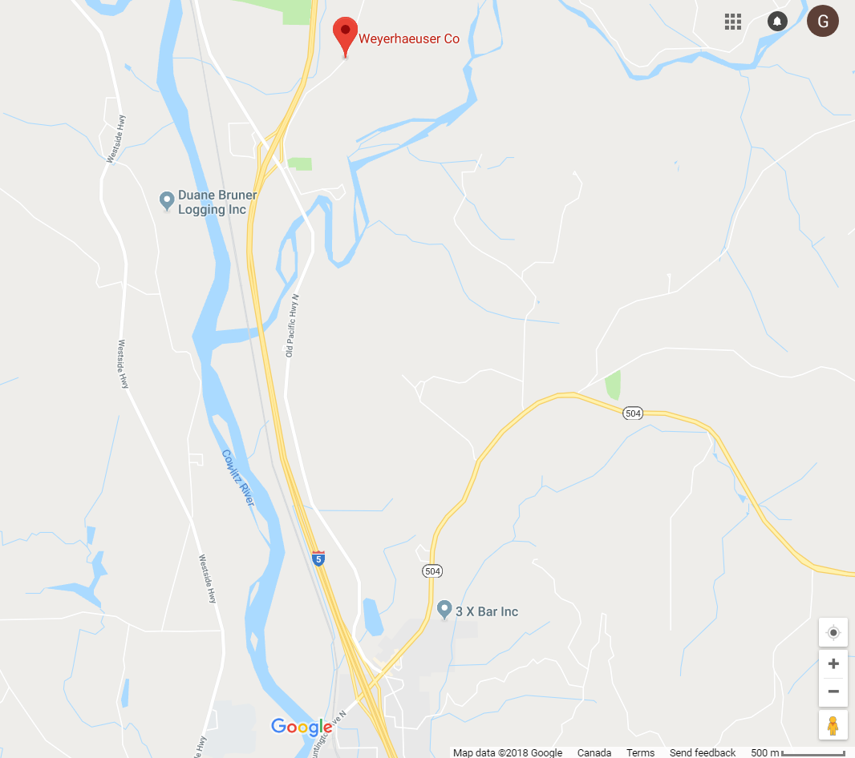
Get key for Mt St Helens AMAT from Weyerhaueser office at 500 Burma Road. Take exit 52 Barnes Road, 4 km north of Castle Rock.

